Slide 1

Netflix Original Films & IMDB Scores
DILJU D

Slide 2

CONTENTS
INTRODUCTION
DATA COLLECTION
DATA ANALYSIS
DATA VISUALIZATION
CONCLUSION

Slide 3

INTRODUCTION
Netflix is a streaming service that offers a wide variety of award-winning TV shows, movies, anime, documentaries and more – on thousands of internet-connected devices.
It is the world's leading streaming entertainment service with 208 million paid memberships in over 190 countries enjoying TV series, documentaries and feature films across a wide variety of genres and languages.

Slide 4

DATA COLLECTION
This dataset consists of all Netflix original films released as of June 1st, 2021. Additionally, it also includes all Netflix documentaries and specials. The data was web scraped off from Wikipedia page and got the file from kaggle.
Dataset represents :
Title of the film
Genre of the film
Original premiere date
Runtime in minutes
IMDB scores (as of 06/01/21)
Languages currently available (as of 06/01/21)

Slide 5

OBJECTIVES
Find how factors in the dataset affect the language, rating and other factors of a movie.
See if these factors vary from one category to another.

Slide 6
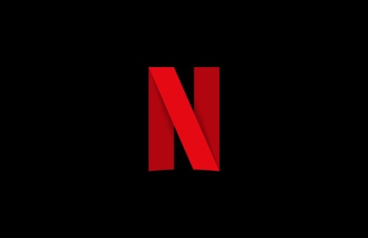
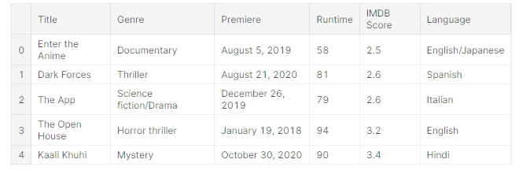
DATA ANALYSIS
The dataset consists of 584 rows and 6 columns. For the easy analysis of the dataset, we can start creating three new features from the premier date by extracting the date, month and year, we will transform the Premier column into a more convenient date field.

Slide 7
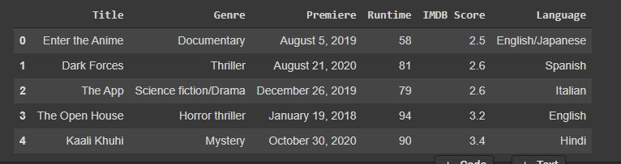
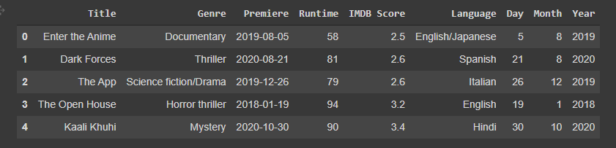

Slide 8

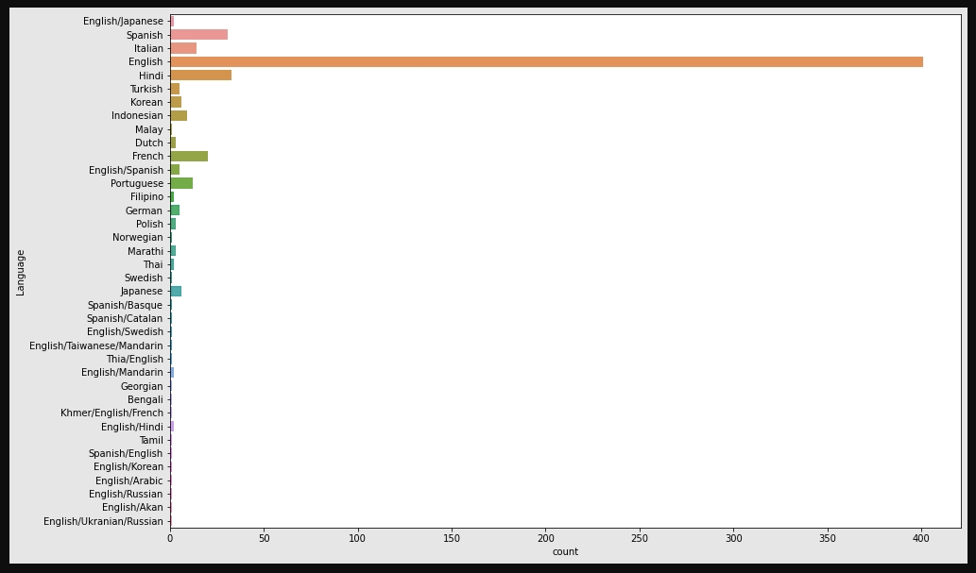
DATA VISUALIZATION

Slide 9

Does language affect in number of movie counts?
As netflix is an American over-the-top content platform and production company headquartered in US, most of the contents in netflix is English language.
Even though there are so many international movies on netflix by now. It is because there are currently more subscribers internationally than within USA. And as the rules of supply and demand go, it implies that there ought to be a greater proportion of films that satisfy international audiences

Slide 10

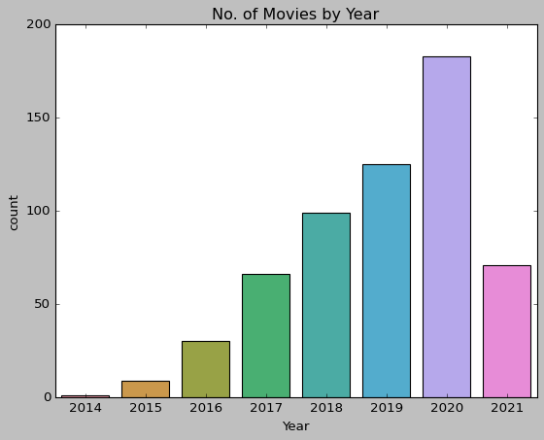
Does no. of movies get increasing by year ?
From the graph
We can confirm that net flix is releasing more and more movies as times goes on. 2021 has a sudden decrease, but this could be because the dataset ends there.

Slide 11

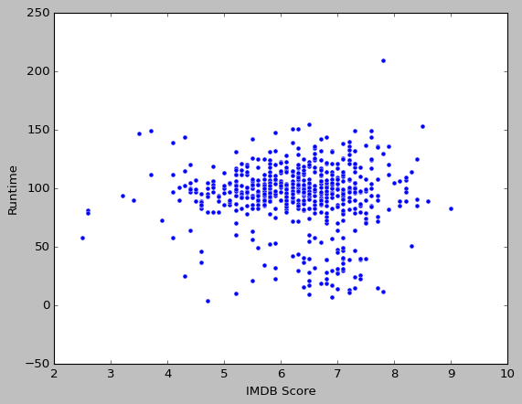
Does movie runtime affect rating?
The scatter plot shows the relation between the movie runtime and IMDB score.
From the plot we can understand that IMDB Score doesn't have anything to do with runtime.
Most of the Movies Runtime lies between 50-150 and most of the movies have IMDB Score in between 5-8

Slide 12

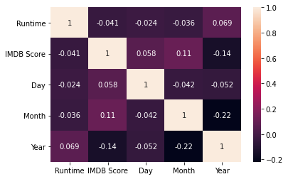
Heat Map
The heat map shows a positive correlation between runtime IMDb score.

Slide 13
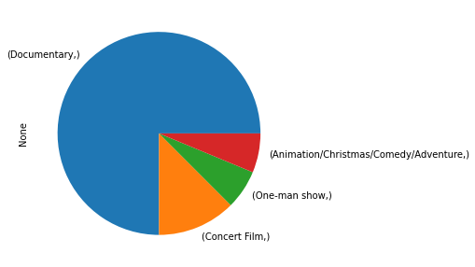
Pie Chart
The pie chart shows the genre with IMDB score greater than 8.
From this it shows that documentaries are more in number with highest IMDB score.

Slide 14

CONCLUSIONS
Netflix releases production more frequent as time advances, increasing the number of series released each month. But, The rating has been decreasing as the number of films increasing, implying that netflix is aiming for catalog diversity that reaches all kind of public.
Language does not affect rating, since English is always present in the top rated movies by language. Not having English as a language might place the movie at the bottom.
The genres are pretty diverse. But, there's a tendency for animated and comedy movies to be on top.

